Slide 1
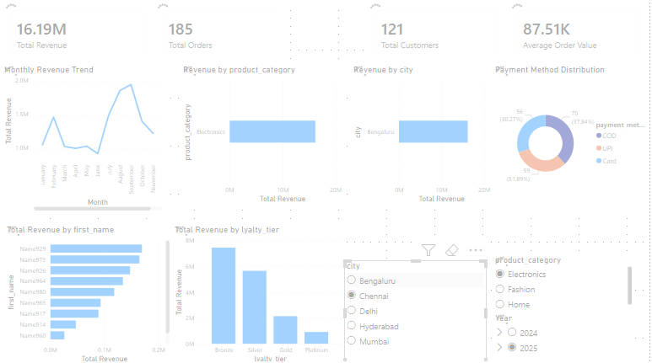
E-Commerce Sales Analytics
Turning Customer & Order data Into Actionable Business Insights
SQL + PostgreSQL + Power BI + Data Analytics
Prepared by: Aishwarya T Dharan

Slide 2
EXECUTIVE SUMMARY
GOAL
Move from descriptive reporting to actionable business recommendations.
OBJECTIVE
Convert raw transaction data into actionable insights for customer growth, retention and commercial decision-making.

Slide 3
EXECUTIVE SUMMARY
Performance
Analyzed 5000 e-commerce orders across 1000 customers
Identified revenue, customer, product and payment trends.
Customer Value
A small group of high value customers contribute significant revenue.
Geographic Performance
Delhi generated the highest city-level revenue.
Bengaluru generated the second highest city-level revenue.
Growth Opportunity
The loyalty analysis indicates an opportunity to move Bronze customers toward higher-value loyalty tiers.
Creating opportunities for targeted retention and personalization.

Slide 4
DATASET OVERVIEW
Data covered approximately two years of transaction activity.
CUSTOMERS
Customer ID, Name, Age, Gender, Signup Date
Loyalty Tier, City, State, Country
ORDERS
Order Id, Customer ID, Order Date, Product category, Order Status, Shipping Method
Product name, Quantity, Unit Price, Discount, Subtotal, Shipping Cost, Tax, Payment Method,
RELATIONSHIP
Customers to Orders: customer-id is Common Column
It connects customers with their corresponding orders, enabling customer-level and transaction-level analysis.

Slide 5
PROJECT OVERVIEW
Imported & structured customer & order datasets in PostgreSQL.
Checked data structure, data types, missing values & consistency.
Joined customer & order information using customer_id
Constructed total_amount using subtotal + shipping cost + tax
Used aggregations, filtering, grouping, sorting, sorting, joins, views to answer business questions
Connected analytics-ready dataset to Power BI for interactive reporting

Slide 6
From Raw Data to Analytics-Ready Data
CSV DATA
POSTGRESQL
DATA CLEANING
BUSINESS QUESTIONS
JOINS & VIEWS
DATA VALIDATION
POWER BI
INSIGHTS
REPORT

Slide 7
Who are our highest-value customers?
Customer Value
Which cities generate the most revenue?
Geographic Performance
How do customers prefer to pay?
Payment Behaviour
Which loyalty tiers contribute the most revenue?
Loyalty performance
Where should management focus its retention and promotional efforts?
Commercial Opportunity

Slide 8
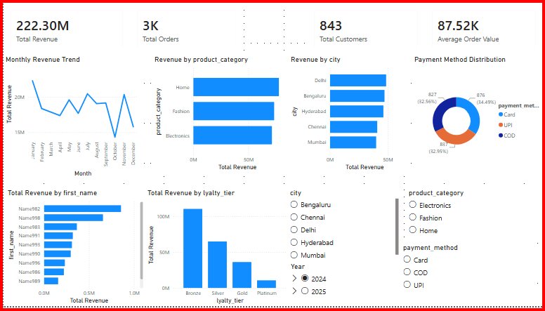
E-commerce Performance Dashboard

Slide 9
BUSINESS INSIGHTS
HIGH-VALUE CUSTOMERS
Finding: The highest value customer generated ₹13,83,241 in revenue and belongs to the highest loyalty tier.
High-value customers represent an important retention opportunity.
GEOGRAPHY
Delhi generated approximately ₹9.5 crore in revenue, followed closely by Bengaluru at ₹9.2 crore.
Delhi and Bengaluru are two major revenue-driving markets.
Action: Prioritize high-tier customers with personalized offers, retention campaigns and loyalty benefits.
Action: Prioritize Delhi for high-impact campaigns while strengthening growth initiatives in Bengaluru & other high-potential cities.

Slide 10
CUSTOMER BEHAVIOUR & LOYALTY
Payment Behaviour
Finding: Card was the most frequently used payment method with approx. 1,700 transactions followed closely by COD at 1,677.
Action: Optimize the card checkout experience while maintaining COD as an important payment option.
Loyalty Performance
Bronze customers generated ₹2.2 crore in revenue, followed by Silver at approximately ₹1.2 crore.
Action: Develop targeted campaigns that encourage Bronze customers to move into higher loyalty tiers.
Cross-Business
Customer value, geography and loyalty data can be combined.
It can identify where high-value customers are concentrated and where targeted campaigns may have the greatest potential.

Slide 11
RECOMMENDATIONS
PRIORITY
High
High
RECOMMENDATION
Protect and personalize high-value customers
Strengthen Delhi campaigns
OBJECTIVE
Retention
Revenue growth
Customer value
Develop Bronze upgrade campaigns
Medium
Long-term
Build customet segmentation
Personalization
Low
Optimize card checkout experience
Conversion

Slide 12
BUSINESS IMPACT
The analysis transforms 5,000 raw transactions into actionable insights for customer retention, geographic expansion and loyalty growth
Identify and protect
high-value customers.
RETAIN
Prioritize high-
Performing markets and loyalty upgrades.
GROW
Use customer
Behaviour to improve payment and marketing decisions.
OPTIMIZE

